Slide 1

DATA ENGINEERING
CHAPTER 4 - JOINS
Laszlo Sallo
SEPTEMBER 2020

Slide 2
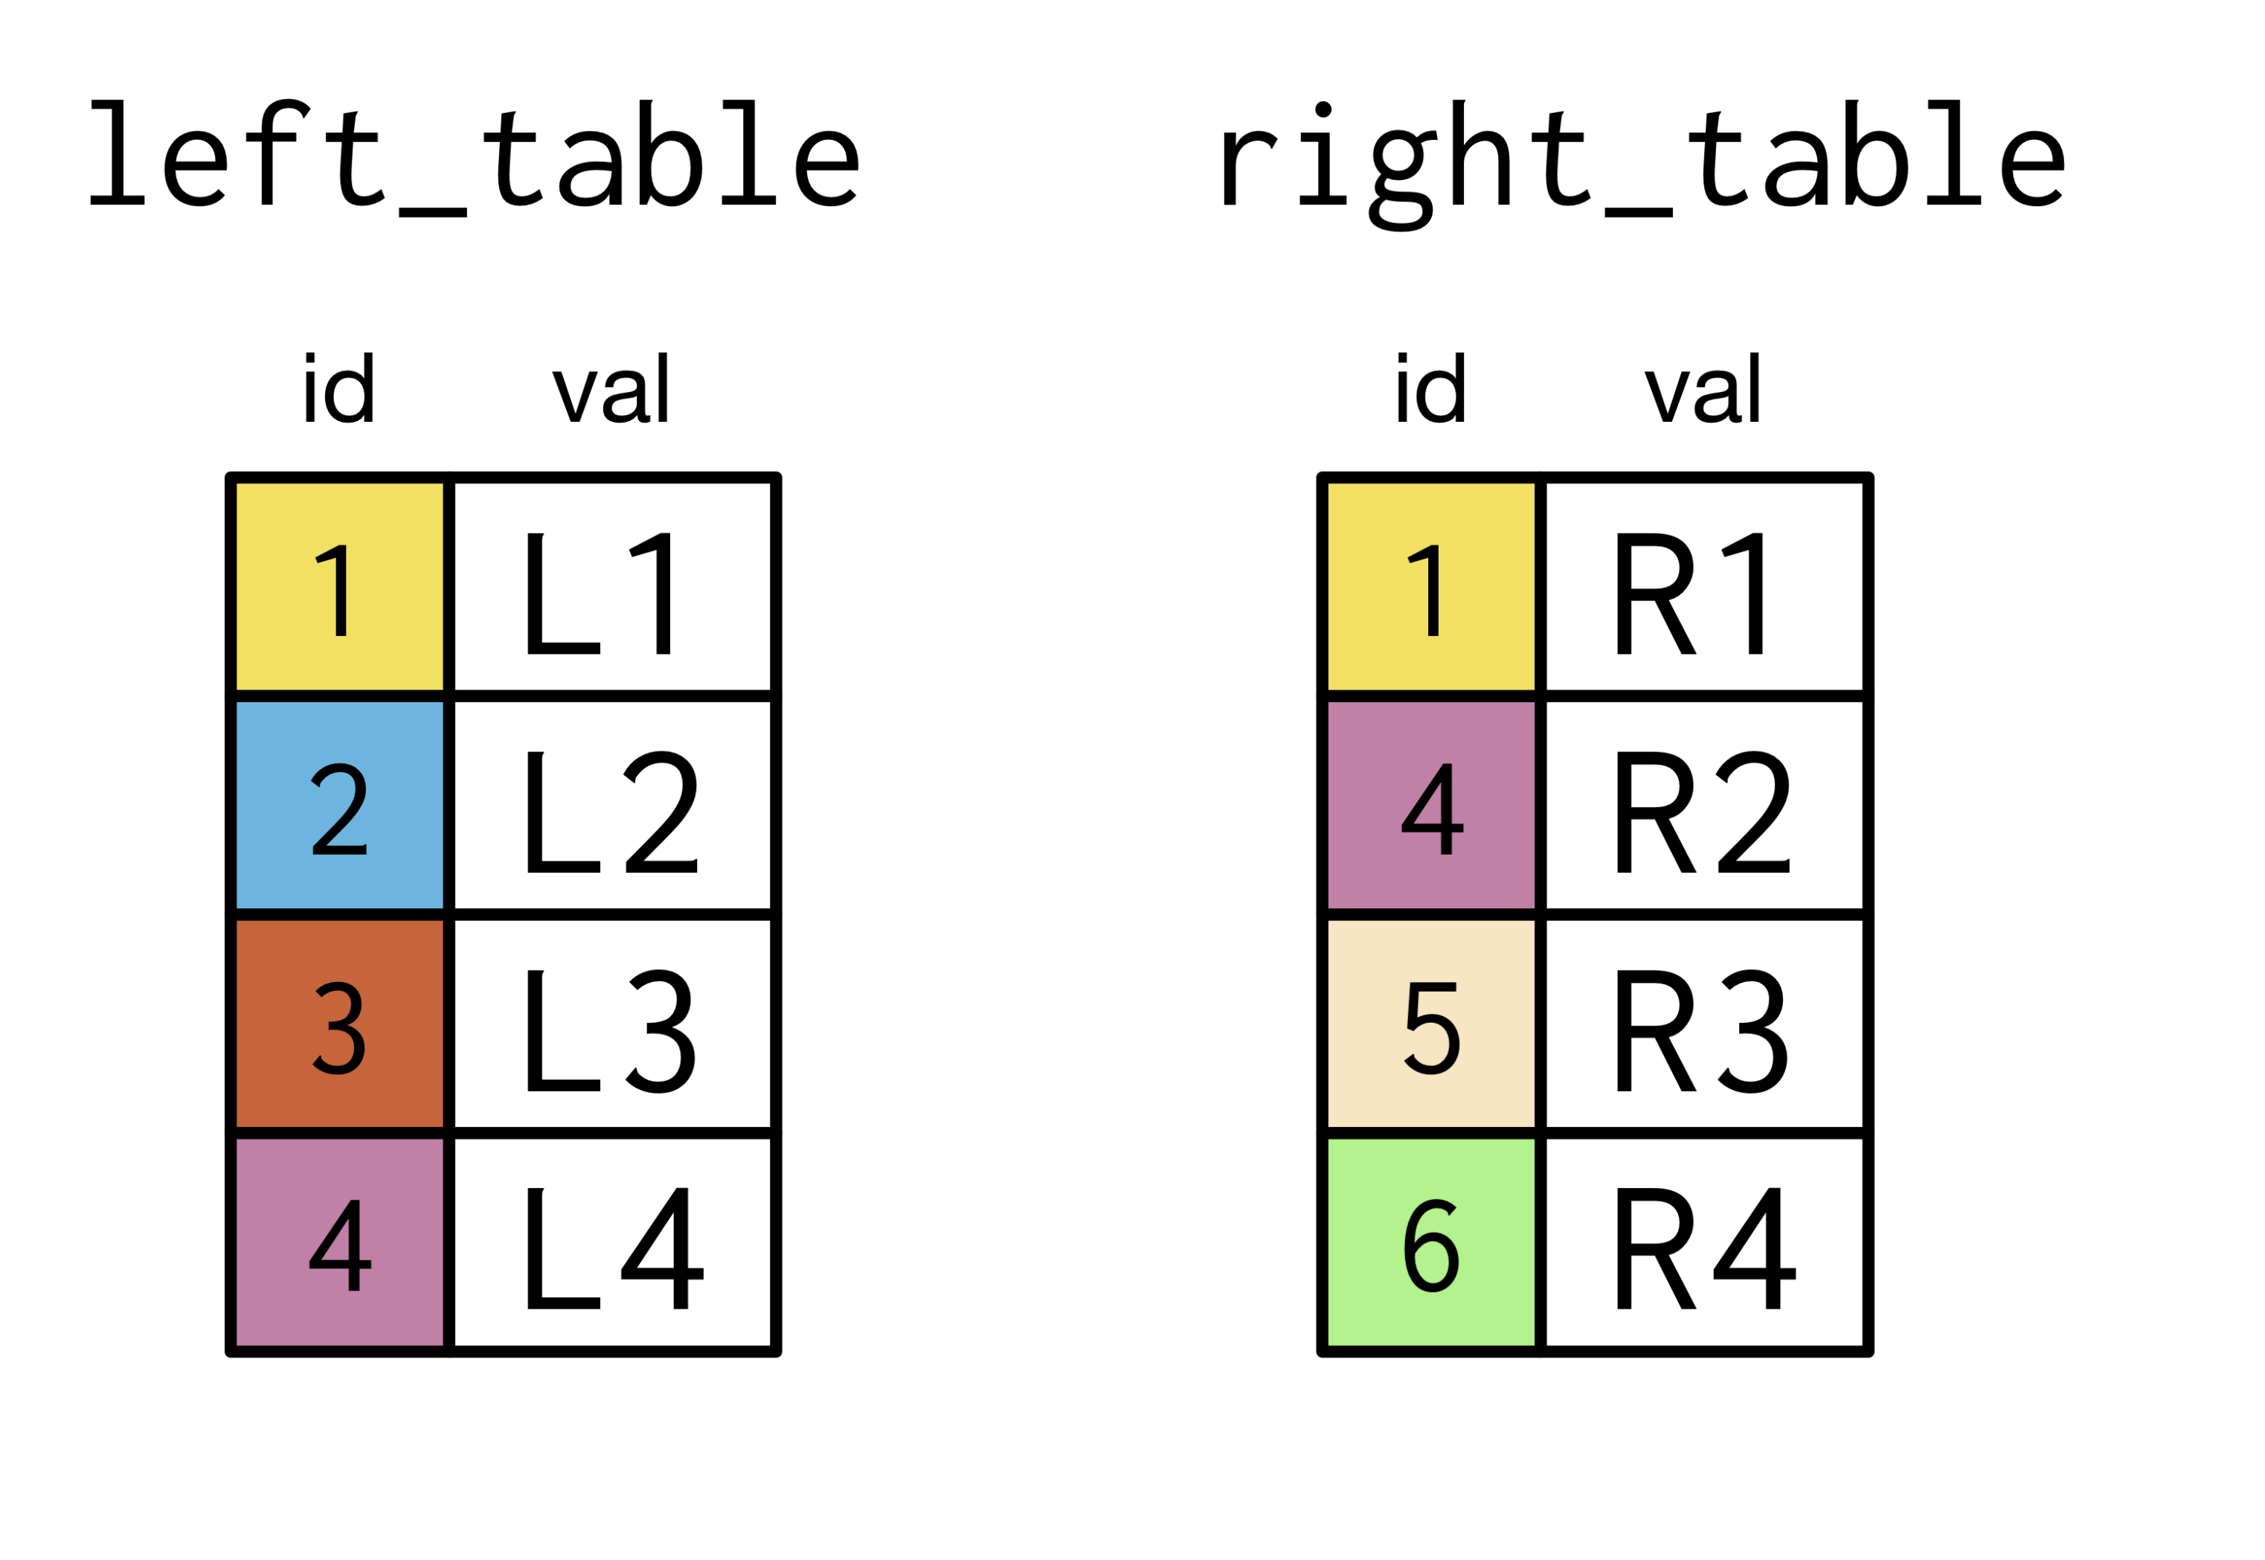
INNER JOIN

Slide 3
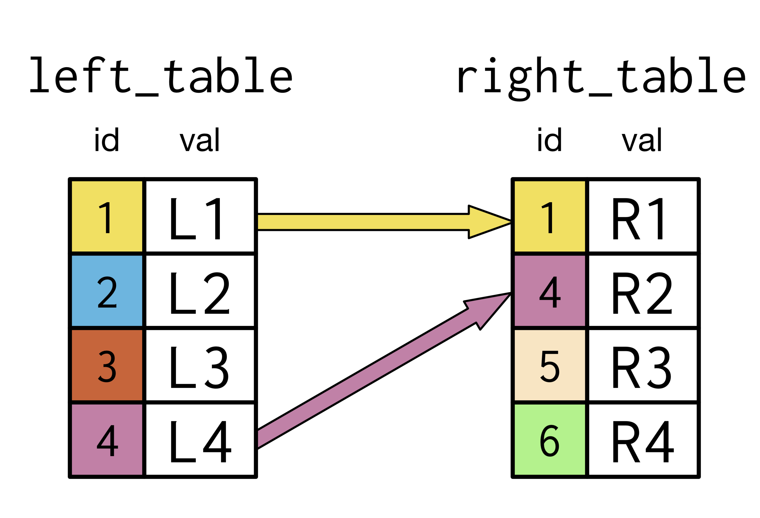
INNER JOIN

Slide 4
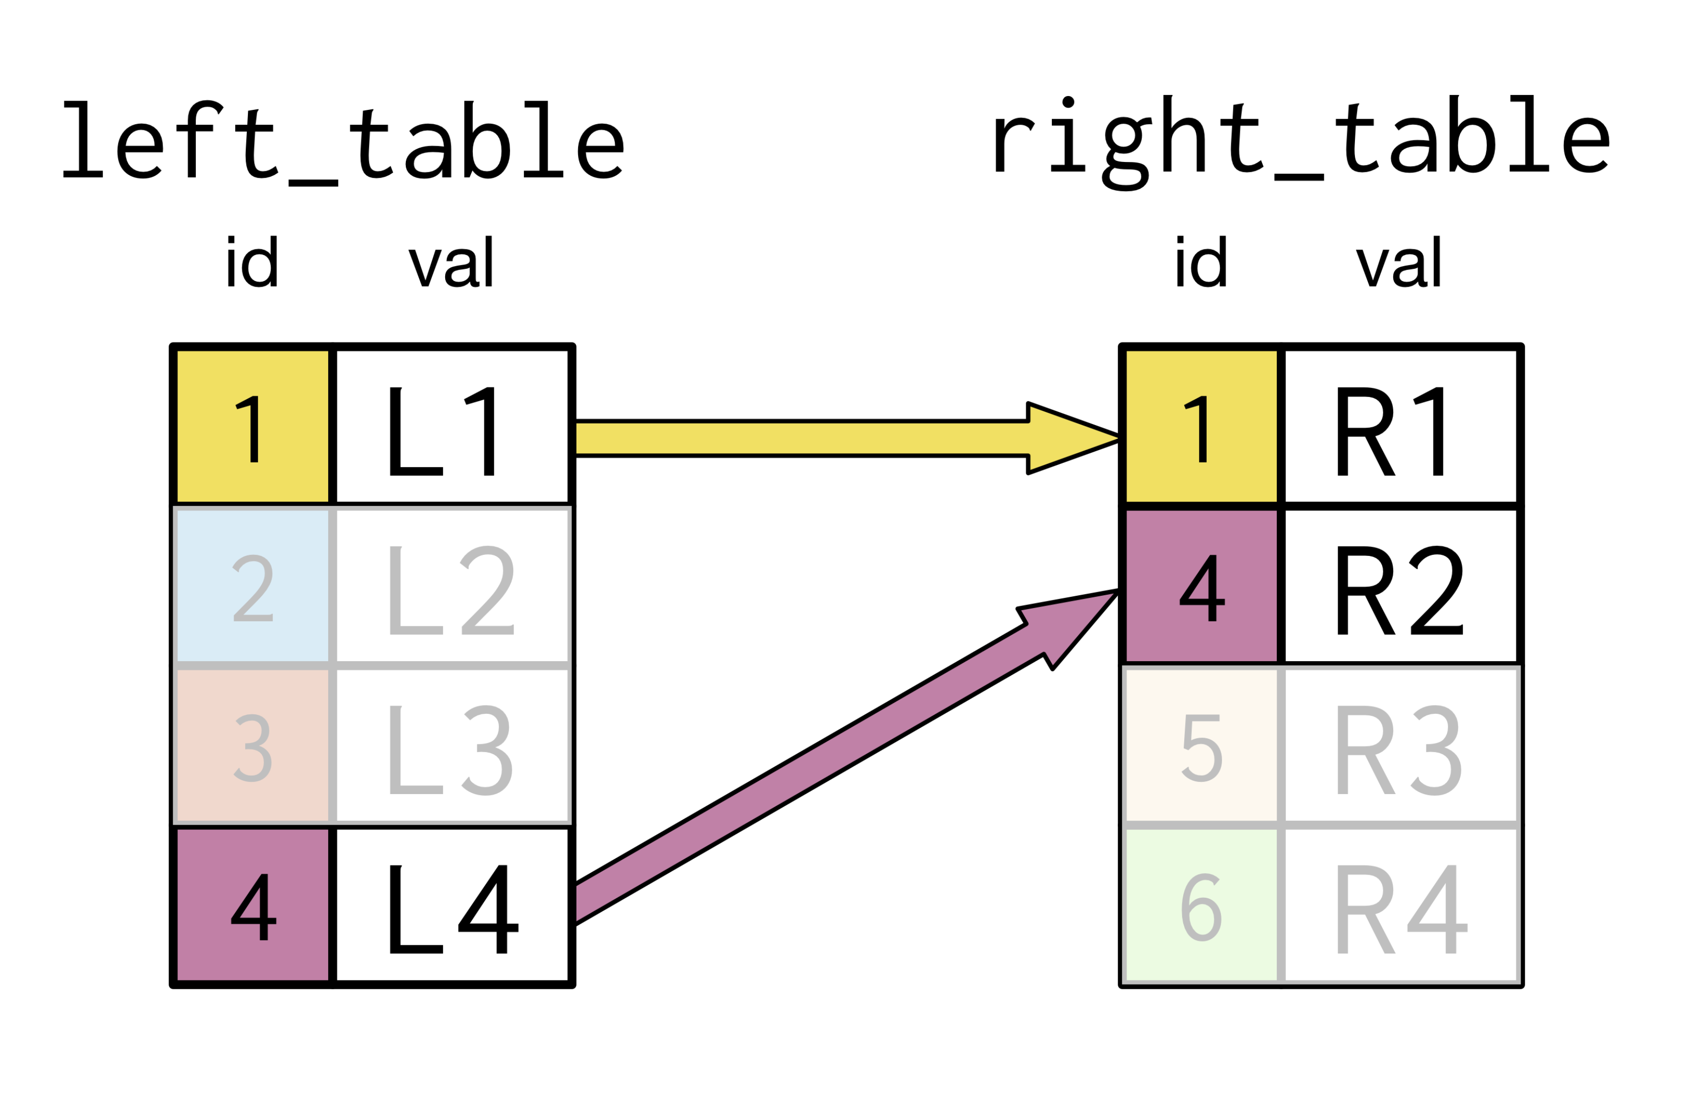
INNER JOIN

Slide 5
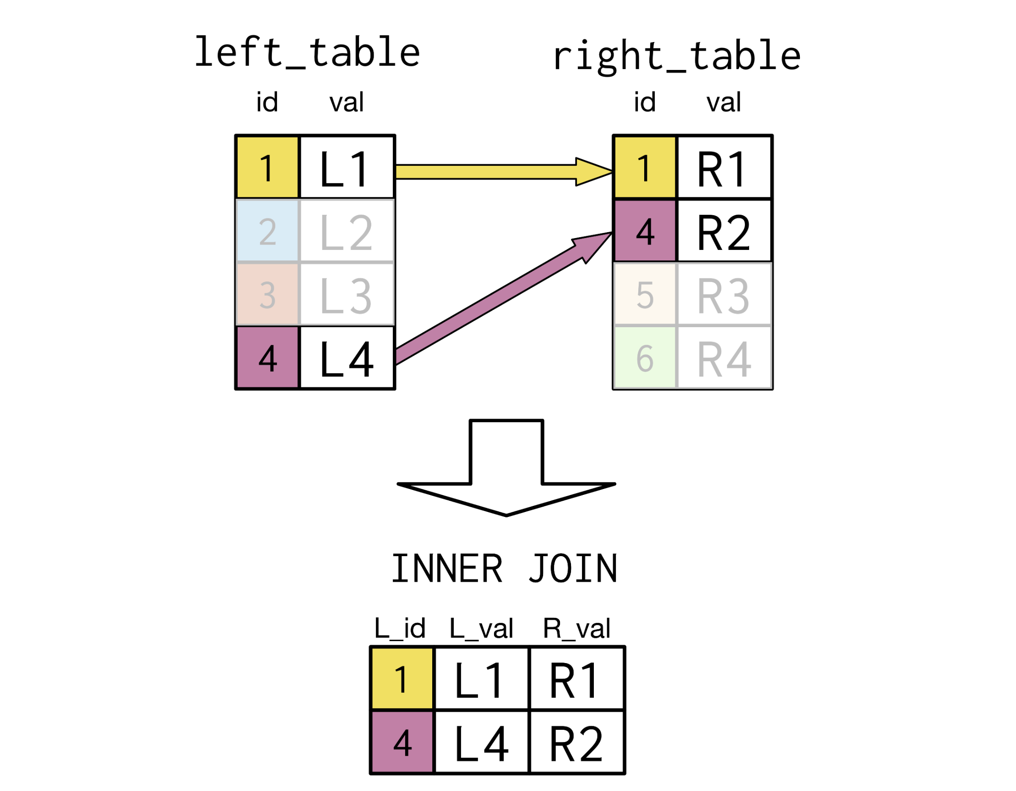
INNER JOIN 1:1

Slide 6
INNER JOIN 1:N

Slide 7
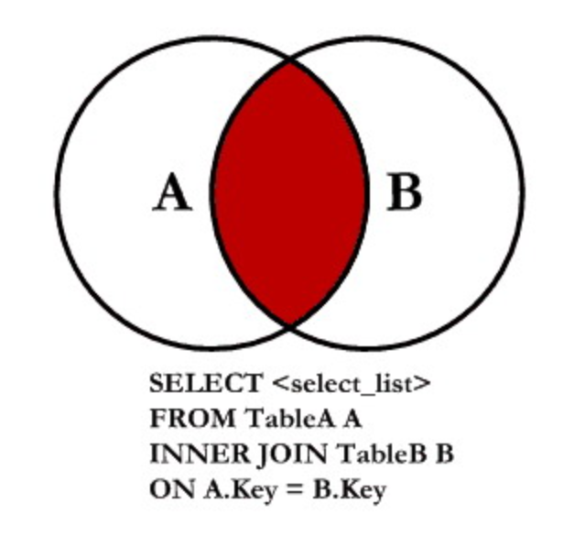
INNER JOIN FORM

Slide 8
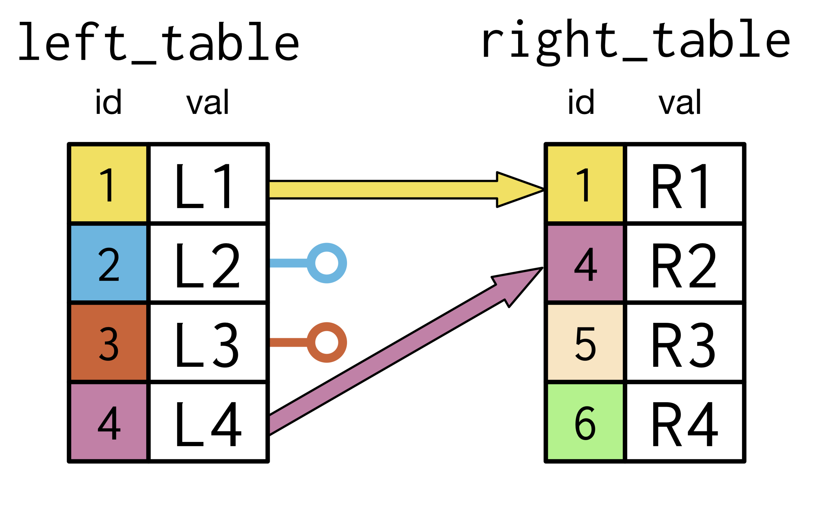
LEFT JOIN

Slide 9
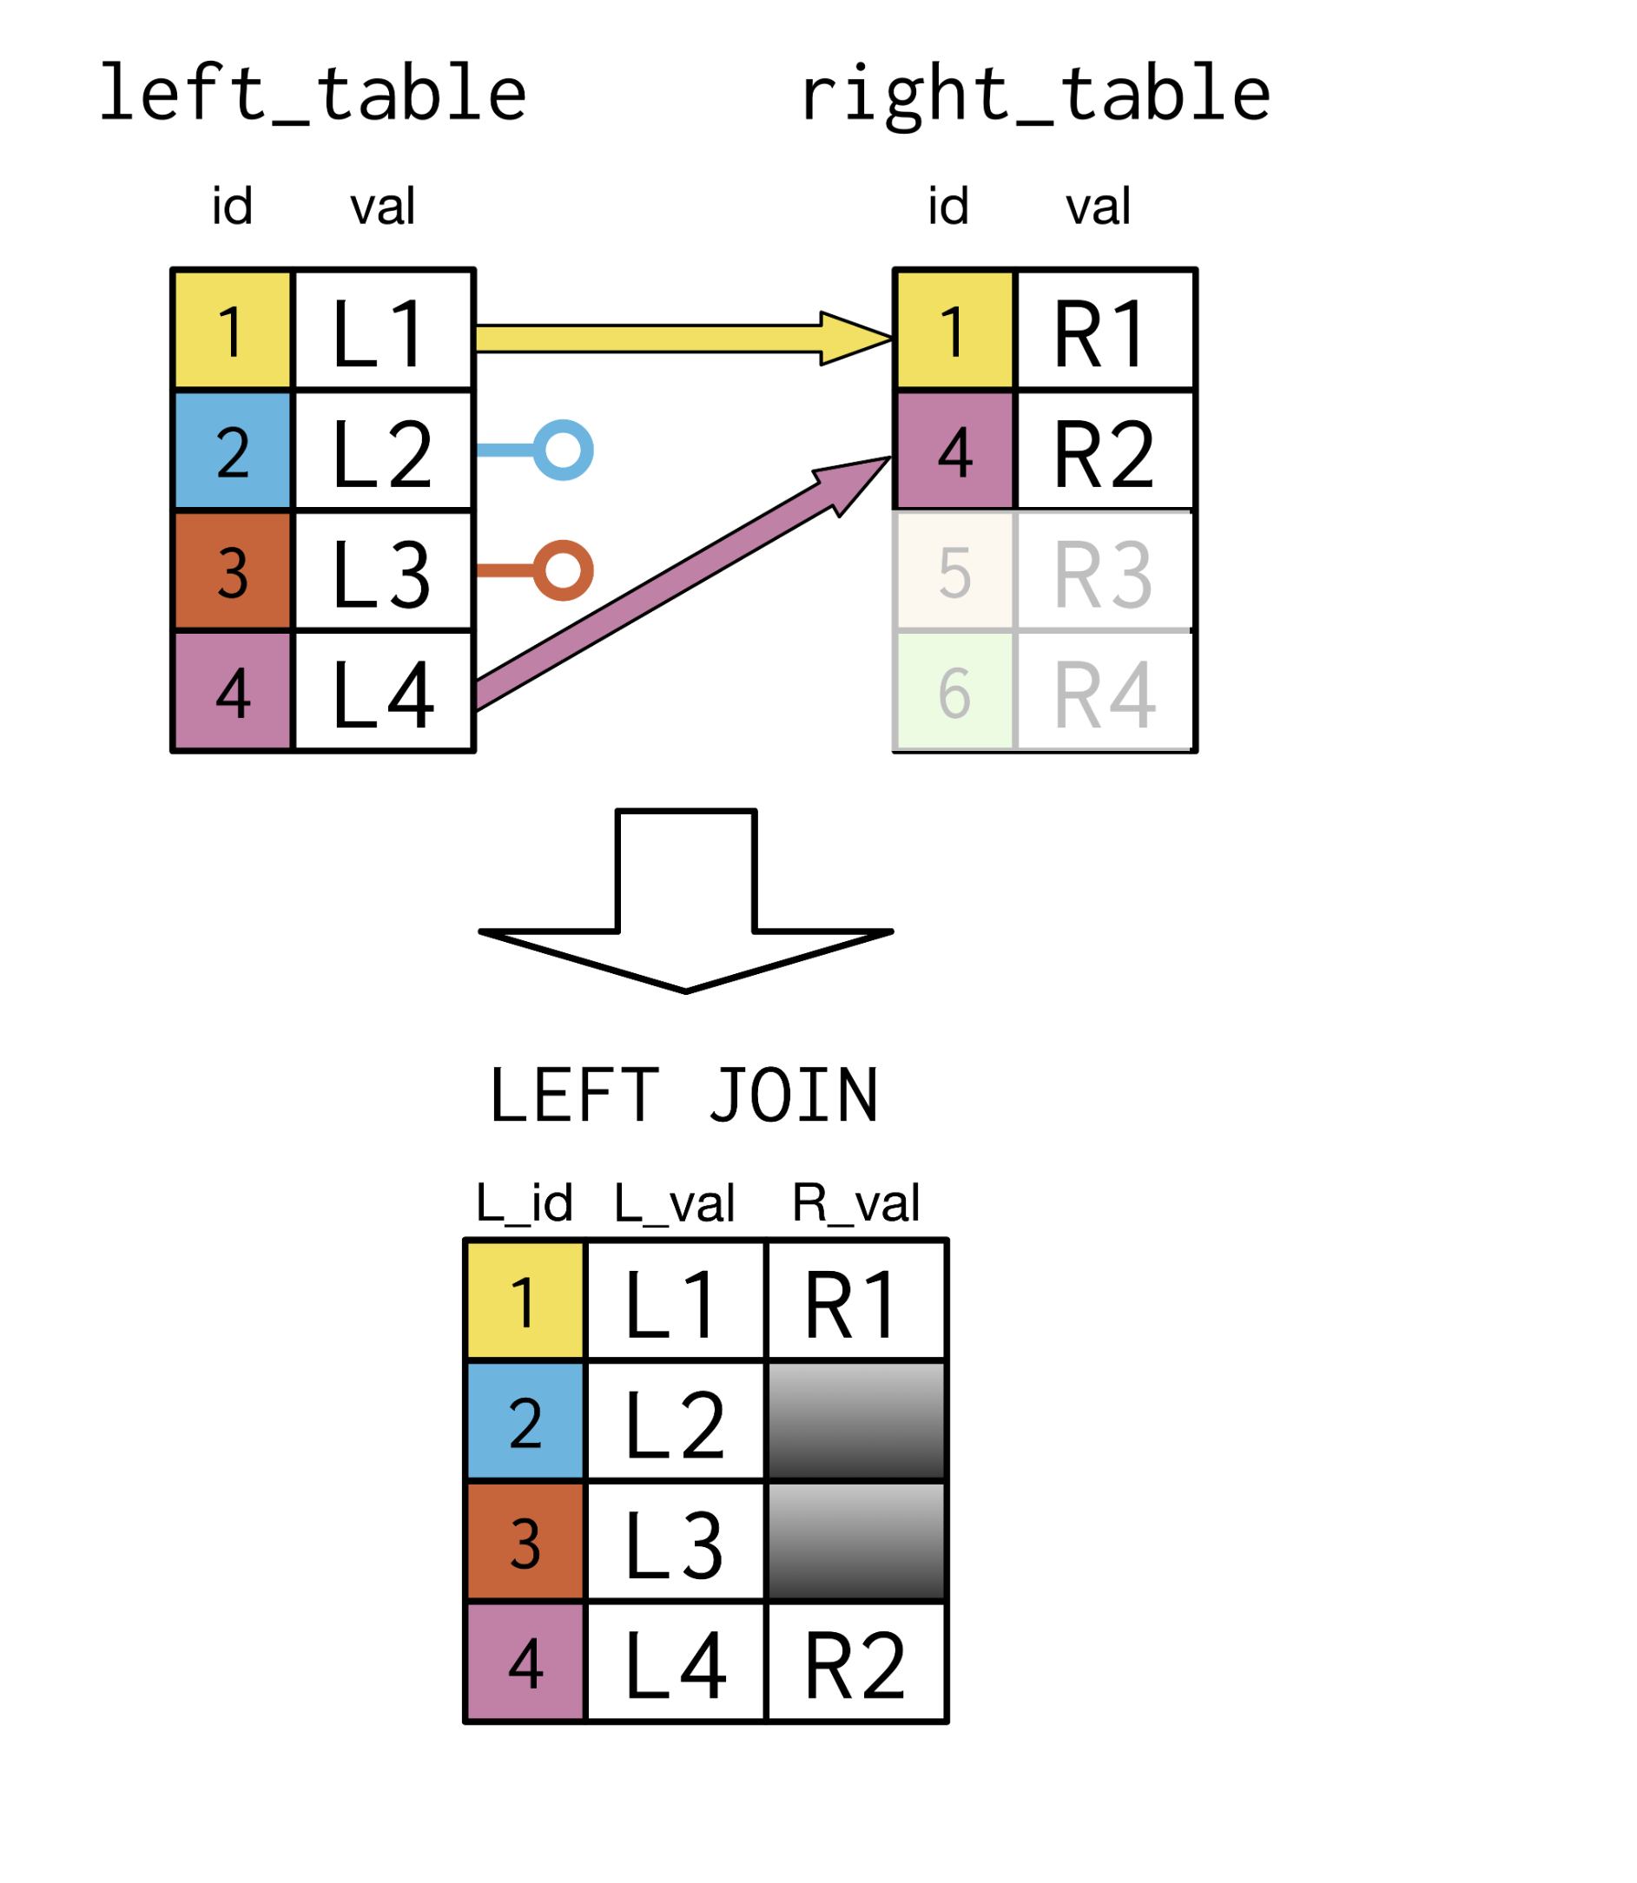
LEFT JOIN 1:1

Slide 10
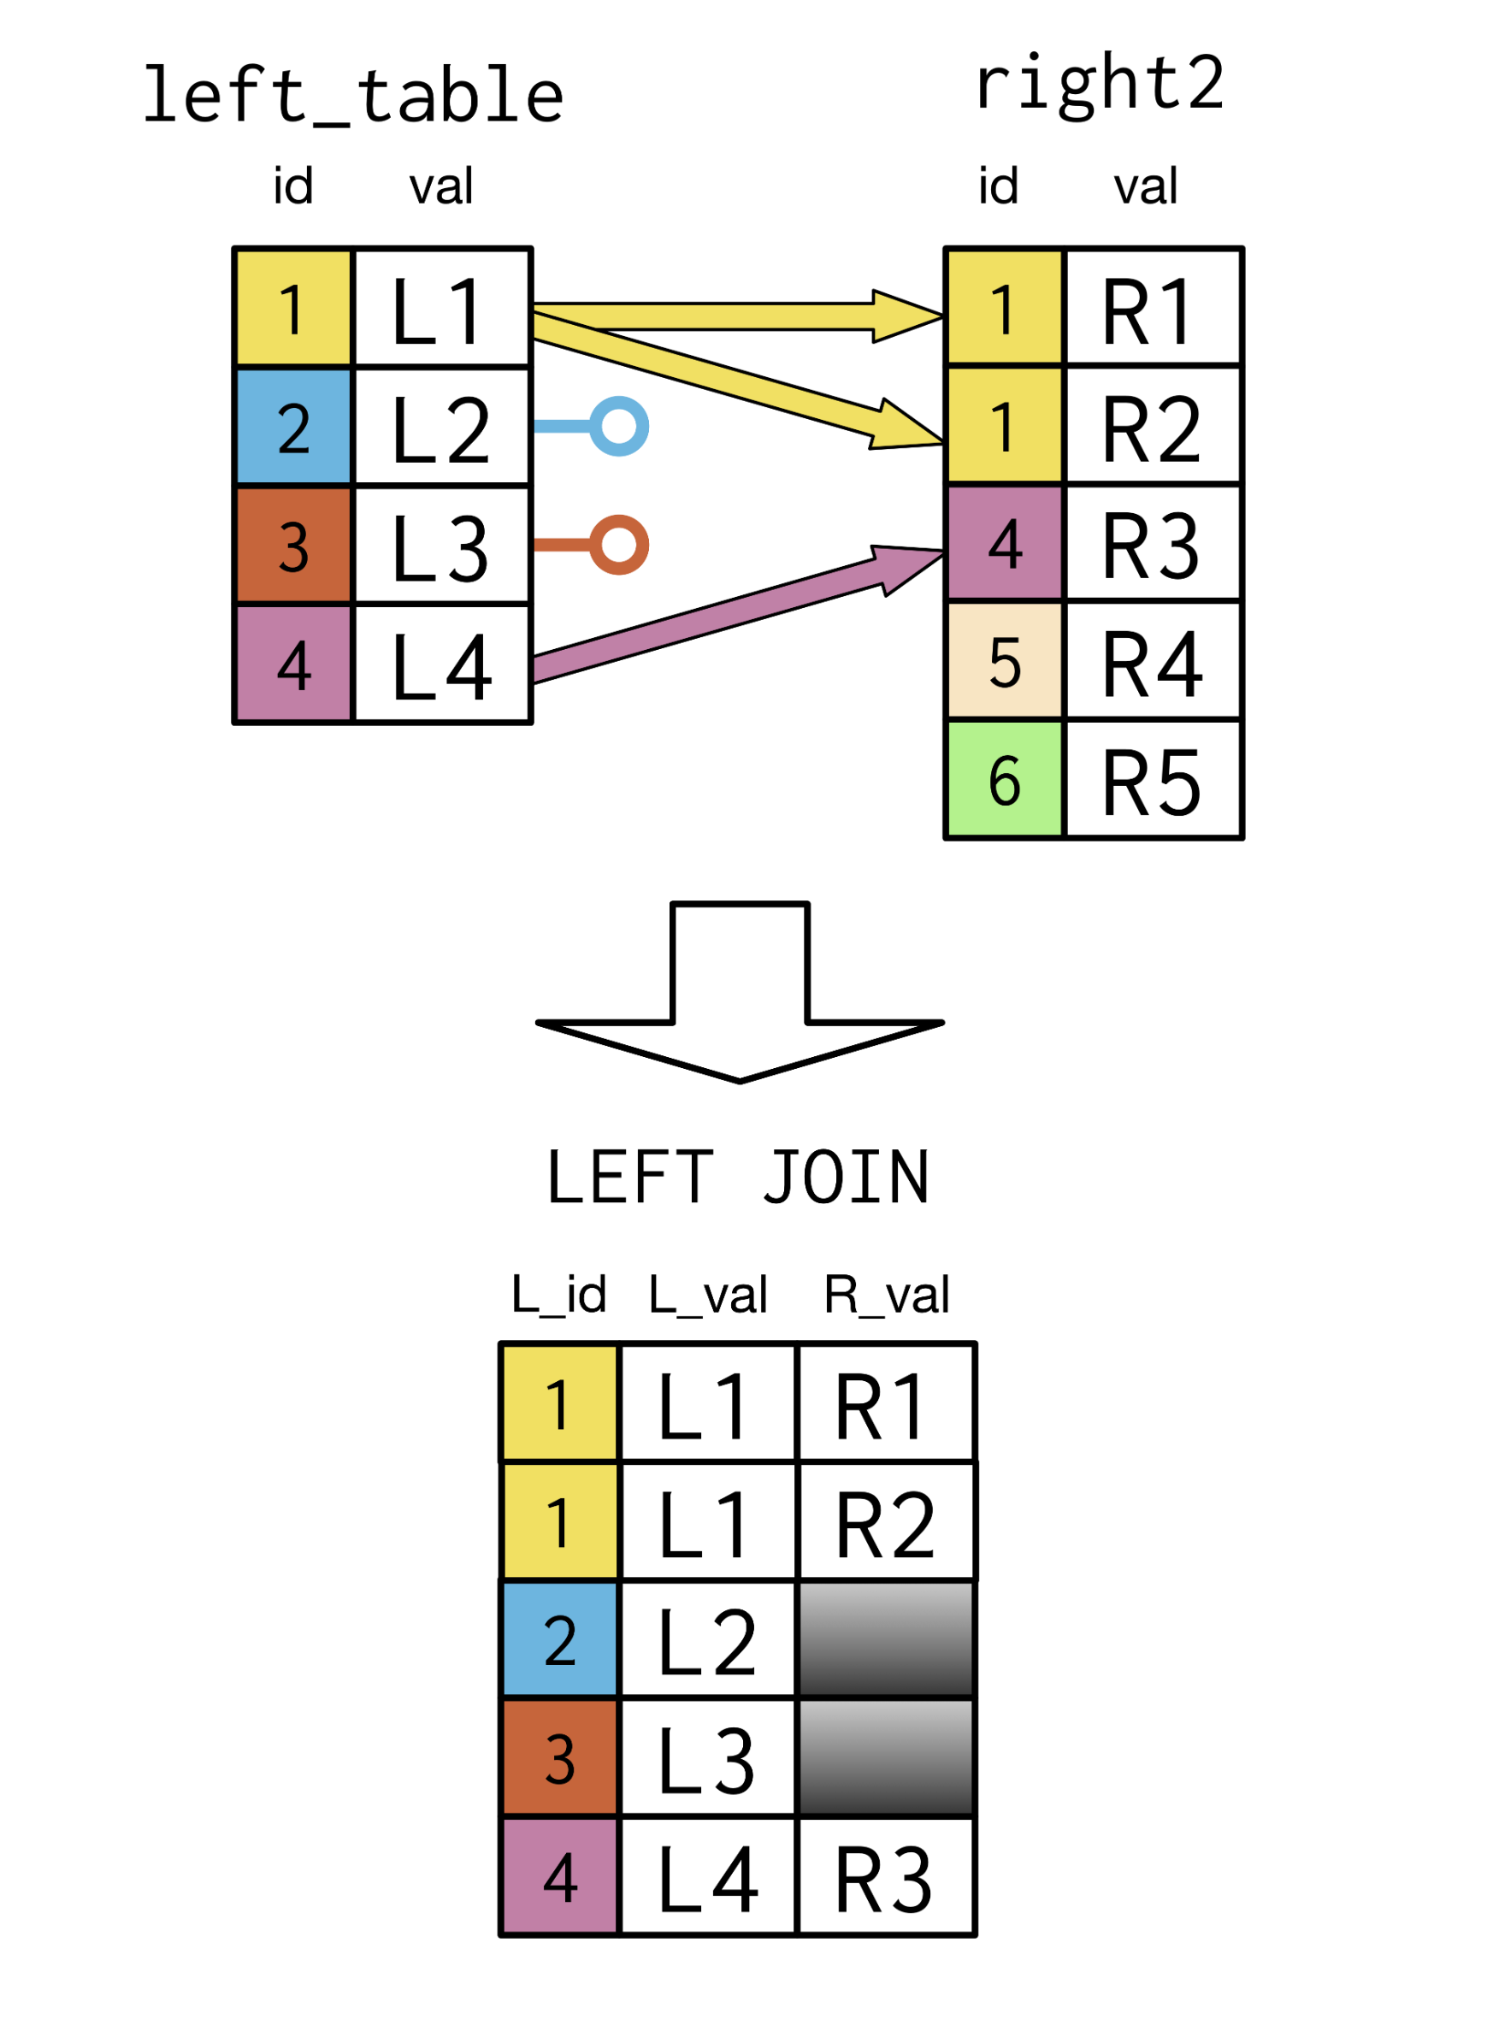
LEFT JOIN 1:N

Slide 11
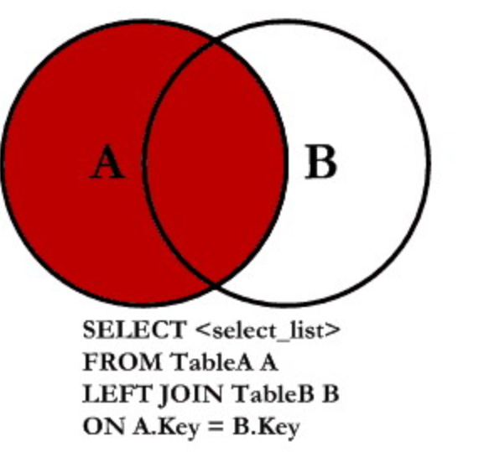
LEFT JOIN FORM

Slide 12
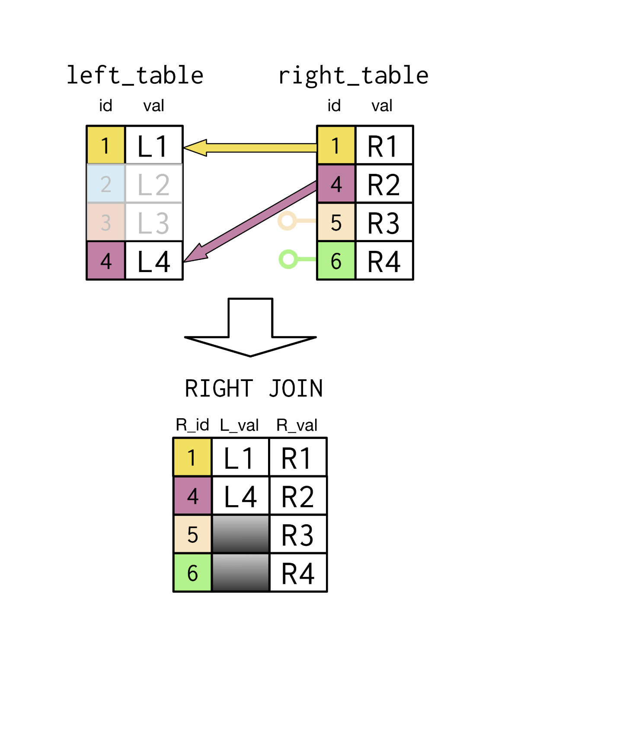
RIGHT JOIN

Slide 13
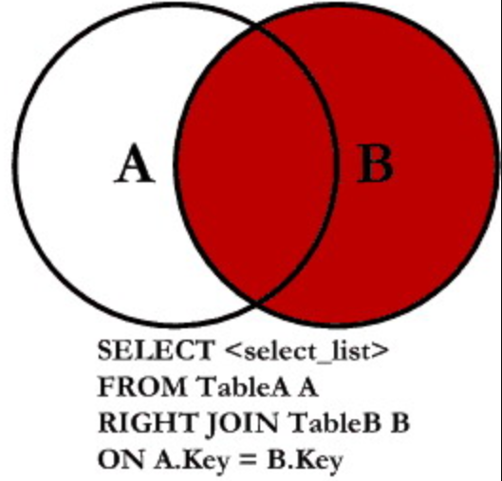
RIGHT JOIN FORM

Slide 14
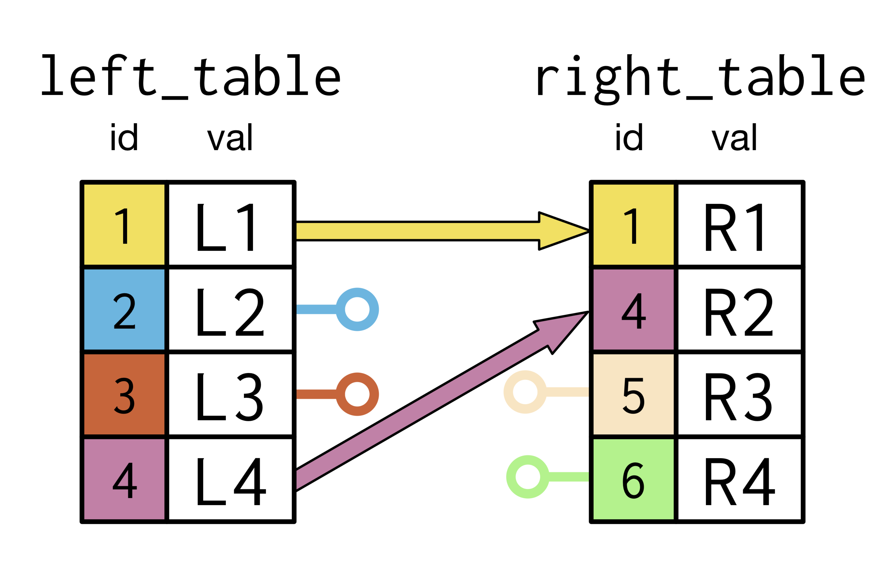
FULL JOIN

Slide 15
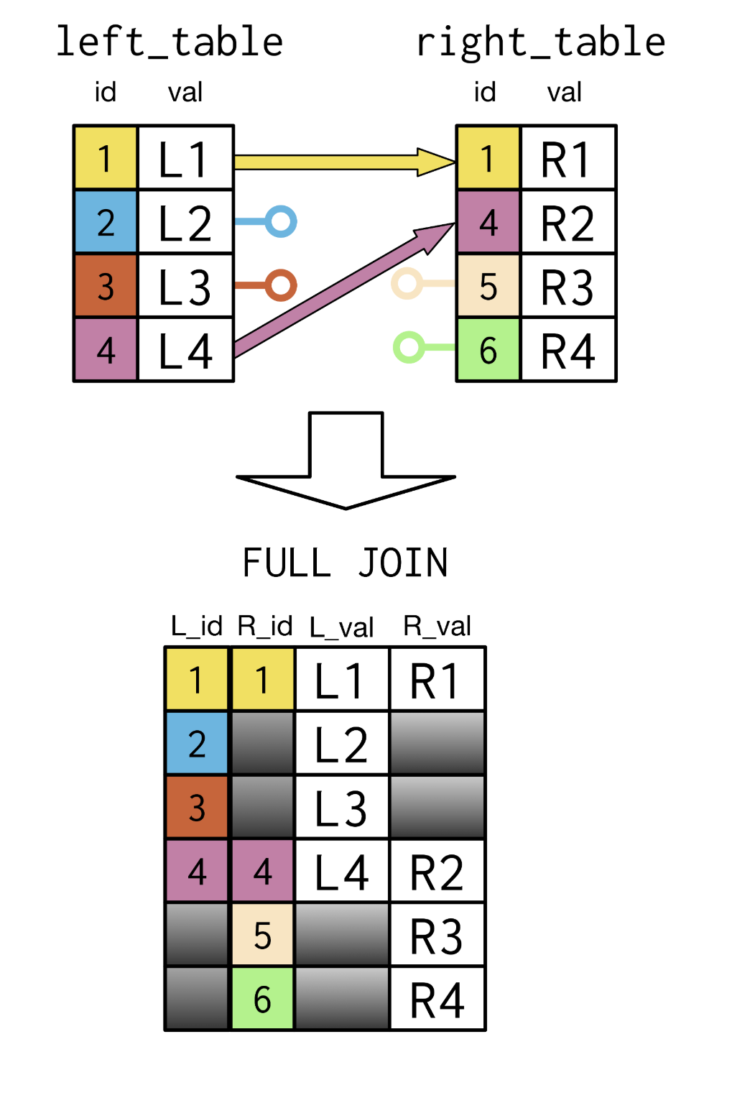
FULL JOIN

Slide 16
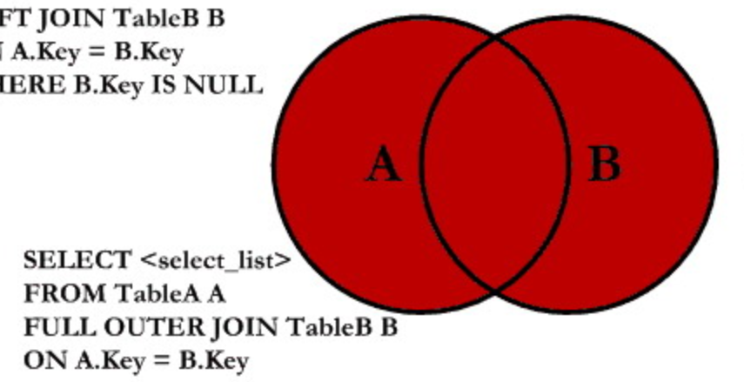
FULL JOIN FORM

